Slide 1
Investigation of Turn-on and Turn-off Characteristics of Enhancement-Mode
GaN Power Transistors
Furkan Karakaya
(furkan.karakaya@metu.edu.tr)
Mesut Ugur
(mesut.ugur@metu.edu.tr)
Ozan Keysan
(keysan@metu.edu.tr)
PowerLab Research Group
Middle East Technical University (METU) - ANKARA
Abstract
Switching Test Circuit Configurations
In this paper, turn-on and turn-off switching behaviour of 650V enhancement-mode GaN power FETs are investigated. An analytical model is developed to analyse the current-voltage characteristics of the device during switching transients both with and without the effects of parasitic components. In addition, the effect of the temperature and circuit parameters on the switching characteristics are investigated.
A Double Pulse Test circuit is implemented in MATLAB / Simulink® platform to investigate switching transients.
GaN Modeling
Blue branch indicates the device channel
The parasitic capacitances are highly dependent on the electrical field between drain-source terminals.
Double Pulse Test (DPT) Circuit Configuration
Table 1: The parameters used for the test circuit in MATLAB / Simulink ®
Input voltage (V_{d}) | 400 V | Internal gate resistance (R_{g}) | 1.5 Ω | Gate parasitic inductance (L_{g}) | 3.0 nH
Output Current (I_{LOAD}) | 20 A | Drain/source inductances (L_{s}) | 0.9 nH | Power loop inductance (L_{p}) | 7.0 nH
Load inductance (L_{LOAD}) | 35 mH | Turn-on gate resistance (R_{G-ON}) | 10 Ω | Junction Temperature (T_{J}) | 125 ⁰C
Applied gate voltage (V_{gs}) | -3V/+6V | Turn-off gate resistance (R_{G-OFF}) | 1 Ω | Dead-time (t_{dead}) | 20 ns
For better understanding of the switching behavior of e-mode GaNs, the turn-on and turn-off behavior of the selected device is investigated with three models:
The hybrid model of e-mode GaN power FET
Model 1: The simplest model with constant capacitances and without parasitic inductances
(a)
(b)
Parasitic capacitances vs Drain-Source Voltage plot (a) & Ciss vs Vgs plot (b)
(a) Top Switch Turn-On
(b) Top Switch Turn-Off
(a)
(b)
(c) Bottom Switch Turn-Off
(d) Bottom Switch Turn-On
Static Results of GS66508B for Forward Conduction (a) & Reverse Conduction (b)
Switching waveforms obtained using Model 1
A negative gate bias increases the reverse conduction loss. Therefore, the negative gate bias level and dead-time duration optimization is very critical for especially high frequency switching applications.
No oscillations since the inductances are not included in the model
Drain current and channel current are different due to the charging & discharging of switches’ output capacitances
Model 2: The model with variable capacitances but without parasitic inductances
Junction temperature is a key factor which affects the trans-conductance of the device
The trans-conductance is nearly halved for every 75ºC increase in junction temperature
Thermal characteristics of GS66508B at 6V gate-source voltage
(a) Top Switch Turn-On
(b) Top Switch Turn-Off

Slide 2
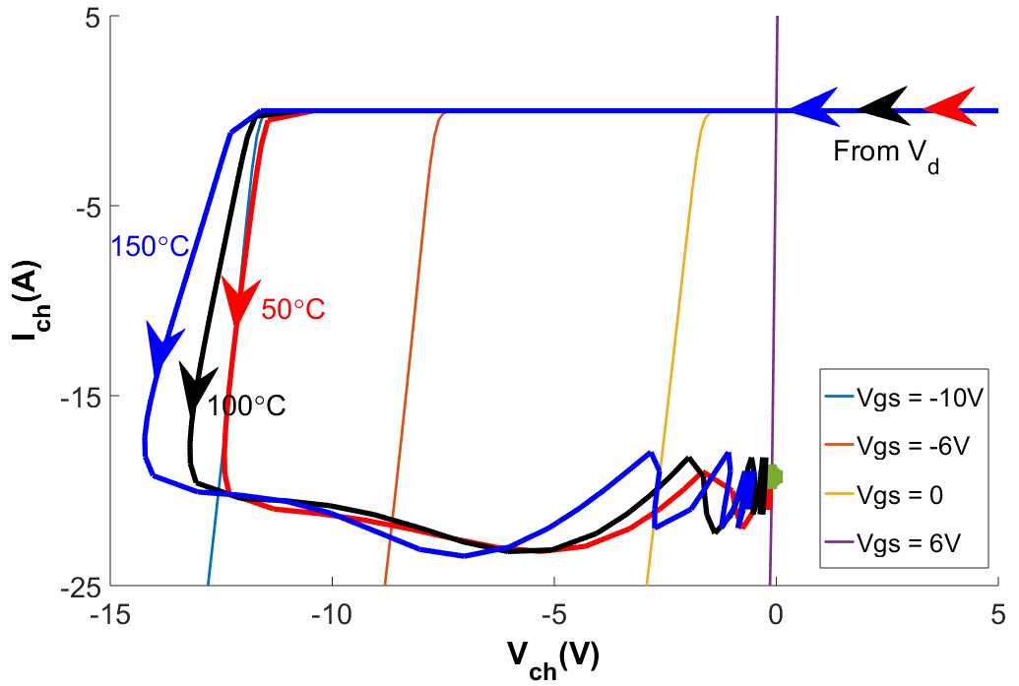
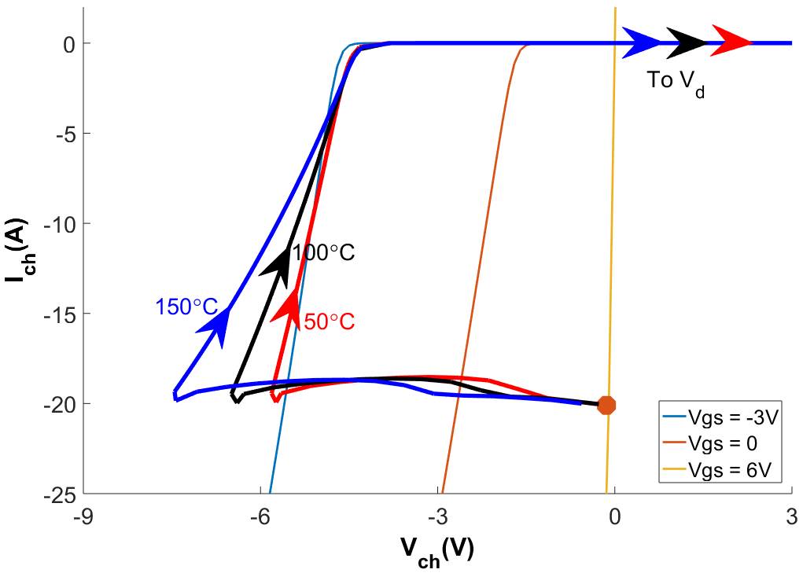
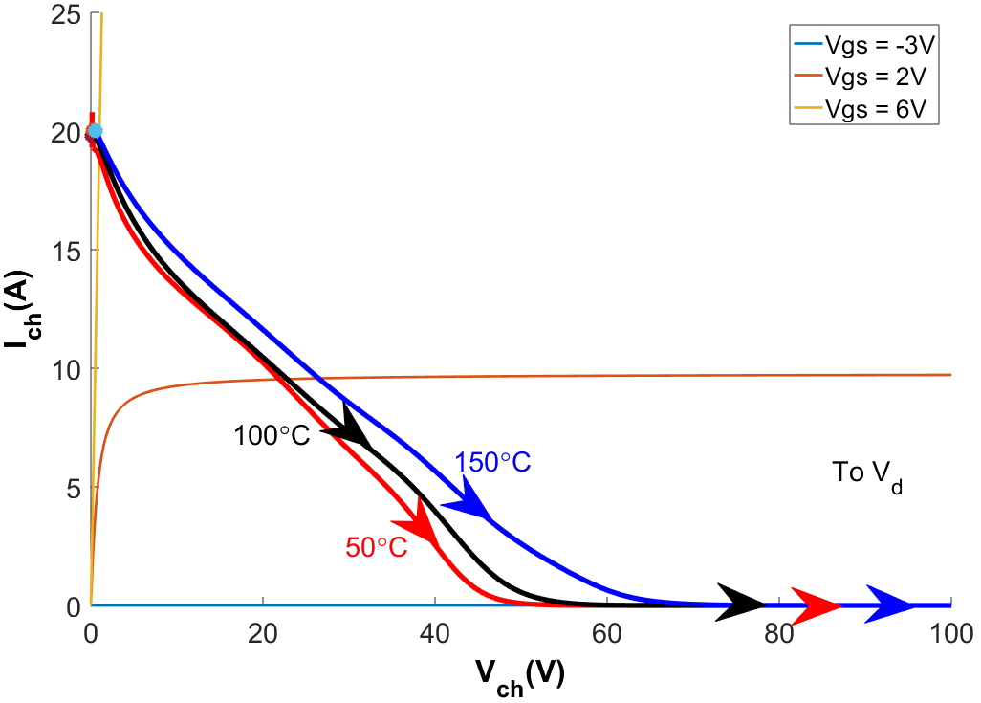
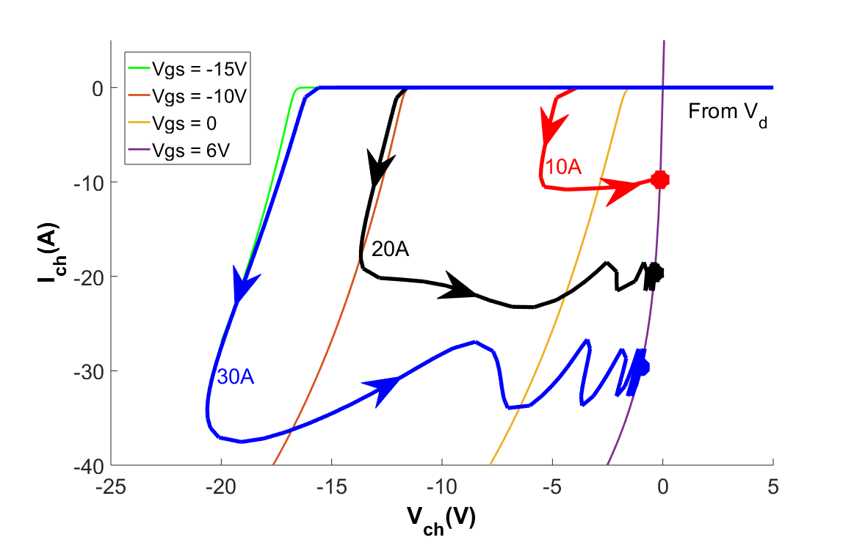
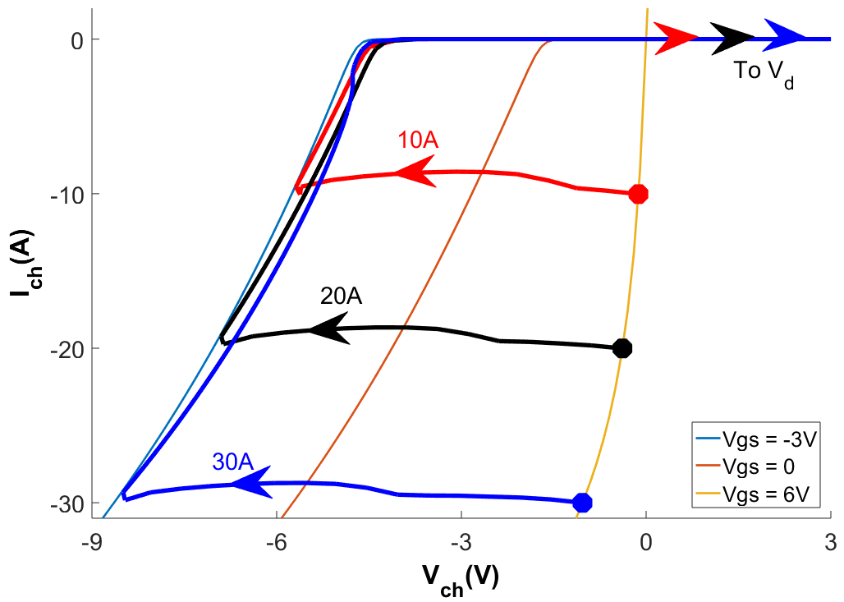
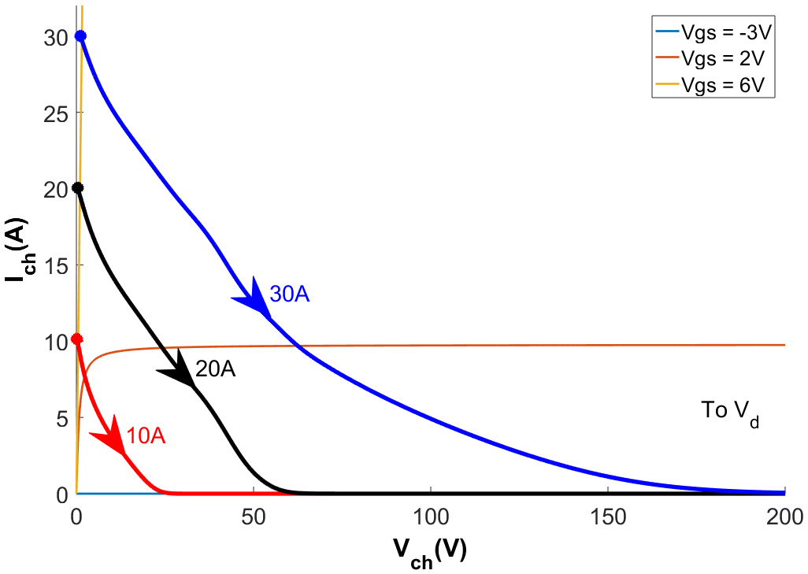
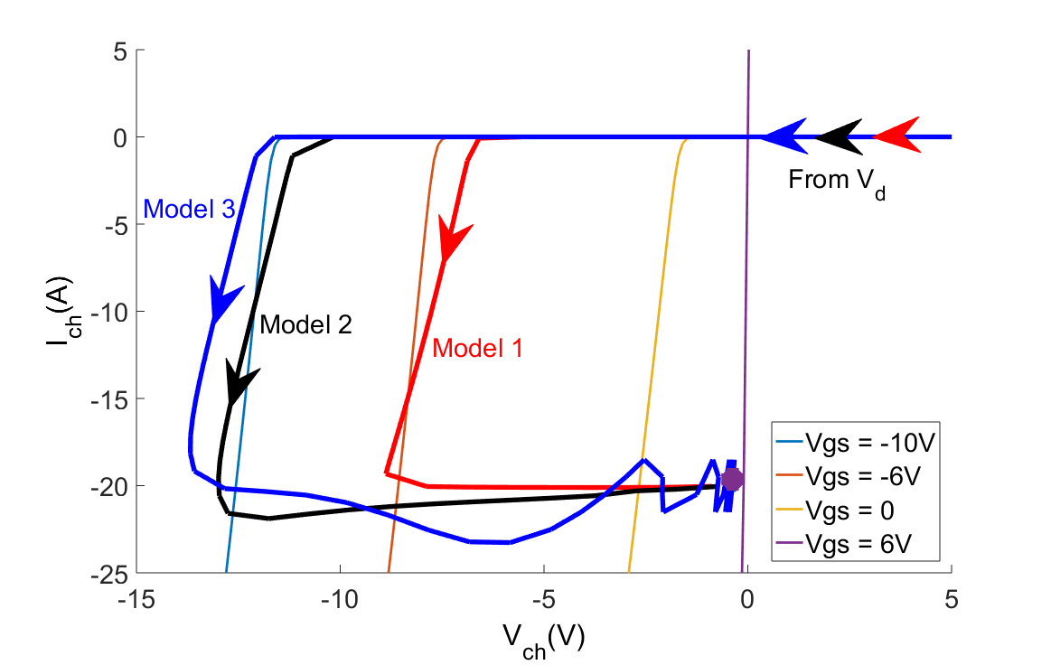
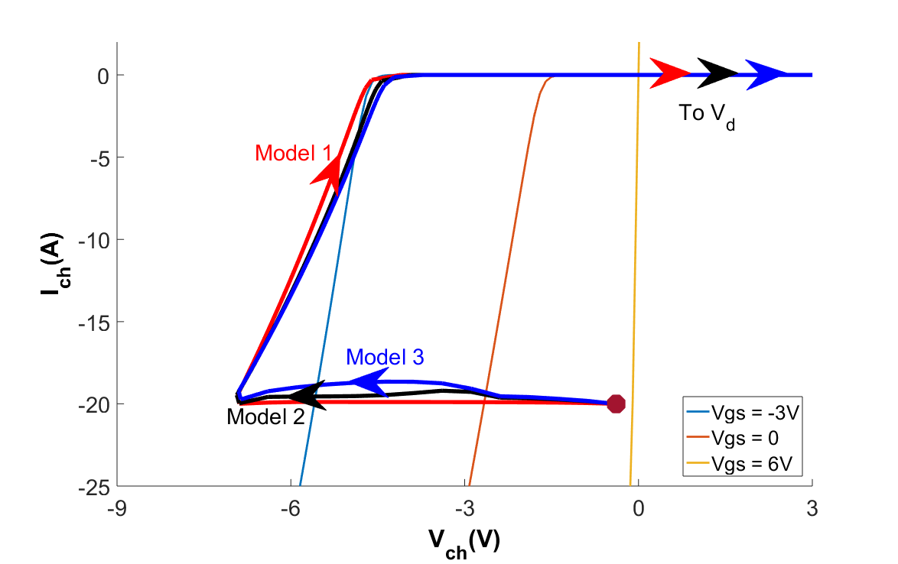
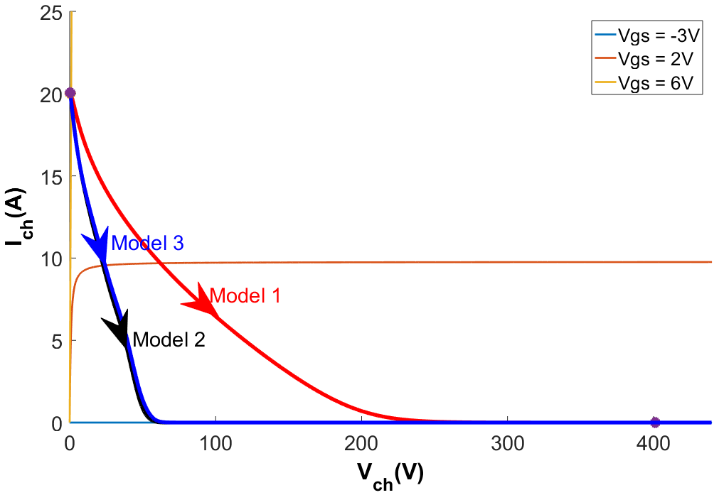
- Part II -
(a) Top Switch Turn-On
(b) Top Switch Turn-Off
(c) Bottom Switch Turn-Off
(d) Bottom Switch Turn-On
Switching waveforms obtained using Model 2
Amplitude of the overshoot in currents increased because for lower voltages now the Coss is greater than the Coss in Model 1
Model 3: The most comprehensive model with variable capacitances and with parasitic inductances
(c) Bottom Switch Turn-Off
(d) Bottom Switch Turn-On
Switching characteristics for different temperatures (Model 3)
Overshoot amplitude and voltage dip is decreased with temperature
The trans-conductance decreases with temperature
(a) Top Switch Turn-On
(b) Top Switch Turn-Off
(a) Top Switch Turn-On
(b) Top Switch Turn-Off
(c) Bottom Switch Turn-Off
(d) Bottom Switch Turn-On
Switching waveforms obtained using Model 3
(c) Bottom Switch Turn-Off
(d) Bottom Switch Turn-On
The all parasitic inductances are added to the model
A large dip in voltage is observed during bottom switch turn-off transient due to the loop inductance.
The damping duration is dependent on the C_{OSS}, loop inductance, drain/source parasitic inductances and trans-conductance [8]
Switching characteristics for different load currents (Model 3)
The gate-voltage level changes dramatically with current level
The voltage dip level is the same for all current levels
Effect of turn-on and turn-off resistances
State Trajectories
(a) Turn-On
(b) Turn-Off
(a) Top Switch Turn-On
(b) Top Switch Turn-Off
Switching waveforms for different turn-on and turn-off resistances (Model 3)
Conclusion
In this study, a GaN device is modeled.
In order to express the unique conduction characteristics of GaN better, active/passive turn-on/off, are explained.
It is shown that increasing operation temperature reduces trans-conductance significantly, i.e. halved for every 75ºC increase
Gate-source voltage is affected by the drain-source current level during the transition while the switching speed is not changed.
Turn-on/off resistors changes Ciss charging/discharging time, so the overshoot amplitudes and switching losses are affected
(c) Bottom Switch Turn-Off
(d) Bottom Switch Turn-On
Switching characteristics as state trajectories (obtained using all the models)
References
The third quadrant behavior of the GaN FETs are unique because the channel is able to conduct in reverse direction with any gate-source bias level. Therefore, the channel can conduct reversely without a positive gate bias and similarly channel might not stop conduction even a negative gate bias is applied.
To make it more clear, active and passive turn-on/off concepts are proposed. An active turn-on/off means the channel starts or stops conduction whatever gate bias level is applied and a passive turn-on/off means the gate bias is changed but the channel continues its conducting or nonconducting state.
[1] Jones, E. A., Wang, F. F., & Costinett, D. (2016). Review of Commercial GaN Power Devices and GaN-Based Converter Design Challenges. IEEE Journal of Emerging and Selected Topics in Power Electronics, 4(3), 707–719. https://doi.org/10.1109/JESTPE.2016.2582685
[2] Jones, E. A., Wang, F., & Ozpineci, B. (2014). Application-based review of GaN HFETs. 2nd IEEE Workshop on Wide Bandgap Power Devices and Applications, WiPDA 2014, 24–29. https://doi.org/10.1109/WiPDA.2014.6964617
[3] Xie, R., Wang, H., Tang, G., Yang, X., & Chen, K. J. (2017). An Analytical Model for False Turn-On Evaluation of High-Voltage Enhancement-Mode GaN Transistor in Bridge-Leg Configuration. IEEE Transactions on Power Electronics, 32(8), 6416–6433. https://doi.org/10.1109/TPEL.2016.2618349
[4] Jones, E. A., Wang, F., Costinett, D., Zhang, Z., Guo, B., Liu, B., & Ren, R. (2015). Characterization of an enhancement-mode 650-V GaN HFET. 2015 IEEE Energy Conversion Congress and Exposition, ECCE 2015, 400–407. https://doi.org/10.1109/ECCE.2015.7309716
[5] Peng, K., Eskandari, S., & Santi, E. (2016). Characterization and Modeling of a Gallium Nitride Power HEMT. IEEE Transactions on Industry Applications, 52(6), 4965–4975. https://doi.org/10.1109/TIA.2016.2587766
[6] Wang, K., Yang, X., Li, H., Ma, H., Zeng, X., & Chen, W. (2016). An Analytical Switching Process Model of Low-Voltage eGaN HEMTs for Loss Calculation. IEEE Transactions on Power Electronics, 31(1), 635–647. https://doi.org/10.1109/TPEL.2015.2409977
[7] GaN Systems, “GS66508B Bottom-side cooled 650 V E-mode GaN transistor Preliminary Datasheet,” pp. 1–16, 2018.
[8] Wang, K., Yang, X., Wang, L., & Jain, P. (2018). Instability Analysis and Oscillation Suppression of Enhancement-Mode GaN Devices in Half-Bridge Circuits. IEEE Transactions on Power Electronics, 33(2), 1585–1596. https://doi.org/10.1109/TPEL.2017.2684094

